Slide 1
Discrete Structures
Spring 2026 – Week 4

Slide 2
Logical Equivalence

Slide 3
Logical Equivalence
Two propositions p and q are logically equivalent if their truth tables are the same.
Namely, p and q are logically equivalent if p ↔ q is a tautology. If p and q are logically equivalent, we write p ≡ q.
P | Q | P ↔ Q
T | T | T
T | F | F
F | T | F
F | F | T
**A tautology is a statement in logic that is always true, no matter whether its variables are true or false.
Example: 𝑝 ∨ ¬𝑝
(This is always true, because either 𝑝 is true or it isn’t)
Logical Equivalence

Slide 4
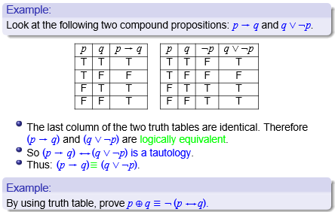

Slide 5
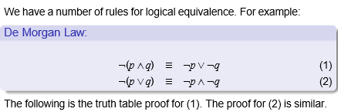
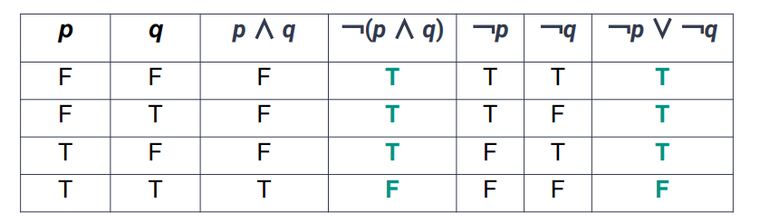

Slide 6
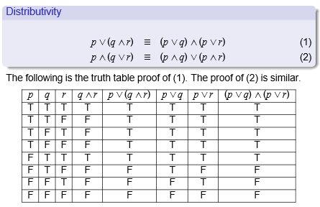

Slide 7
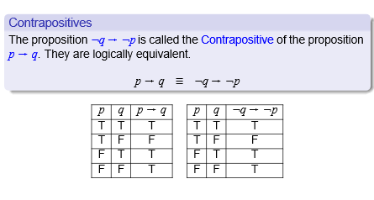

Slide 8
Proving Logical Equivalence
● By using equivalence laws, we can prove two propositions are logically equivalent without having to construct large truth tables
In General:
● Each line should list the law that led to it
○ Exactly one law applied per line
● Start with LHS and go until you reach the RHS

Slide 9
Logical Equivalence using Laws
Equivalence
Name
p ∧ T ≡ p p ∨ F ≡ p
Idenitity Laws
p ∨ T ≡ T p ∧ F ≡ F
Domination Laws
p ∨ p ≡ p p ∧ p ≡ p
Idempotent Laws
Logical Equivalence

Slide 10
Logical Equivalence using Laws
Equivalence
Name
¬(¬p) ≡ p
Double Negation Laws
p ∨ ¬p ≡ T p ∧ ¬p ≡ F
Negation Laws
¬(p ∨ q) ≡ ¬p ∧ ¬q
¬(p ∧ q) ≡ ¬p ∨ ¬q
De Morgan’s Laws
p → q ≡ ¬p ∨ q
Implication Law
p ∨ (p ∧ q) ≡ p
p ∧ (p ∨ q) ≡ p
Absorption Law
Logical Equivalence

Slide 11
Logical Equivalence using Laws
Equivalence
Name
p ∨ q ≡ q ∨ p p ∧ q ≡ q ∧ p
Commutative Laws
(p ∨ q) ∨ r ≡ p ∨ (q ∨ r ) (p ∧ q) ∧ r ≡ p ∧ (q ∧ r )
Associative Laws
p ∨ (q ∧ r ) ≡ (p ∨ q) ∧ (p ∨ r )
p ∧ (q ∨ r ) ≡ (p ∧ q) ∨ (p ∧ r )
Distributive Laws
Logical Equivalence

Slide 12
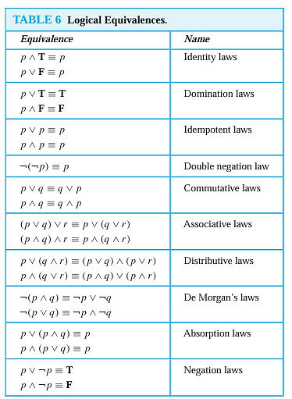

Slide 13
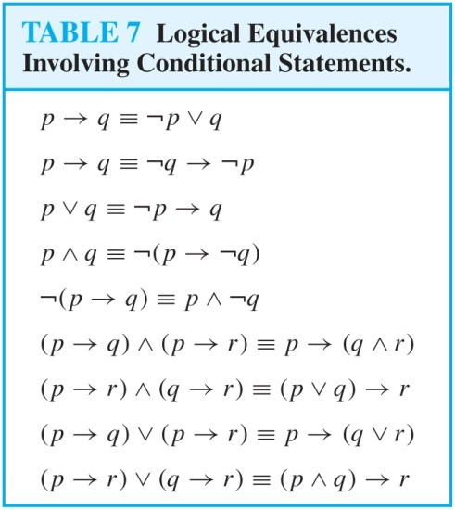
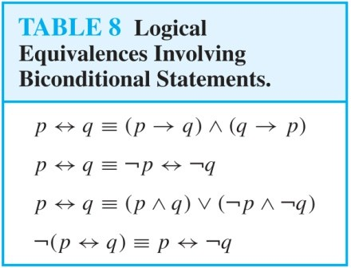

Slide 14
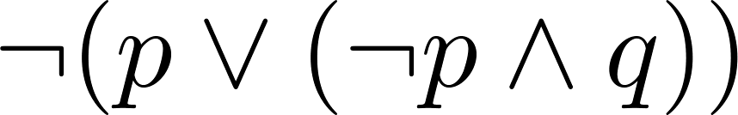
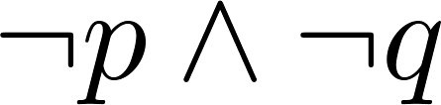
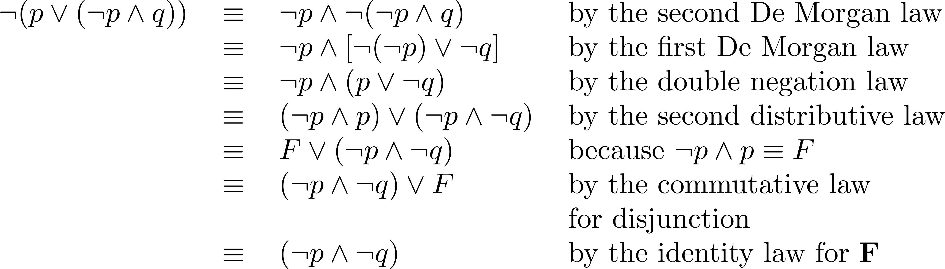
Logical Equivalence using Laws
Example:
Show that
is logically equivalent to
Solution:

Slide 15
Logical Equivalence Using Laws
Is (q ∧ p) ∨ ¬(q → p) ≡ q?
(q ∧ p) ∨ ¬(q → p)
≡ (q ∧ p) ∨ ¬(¬q ∨ p)
≡ (q ∧ p) ∨ (¬(¬q) ∧ ¬p)
≡ (q ∧ p) ∨ (q ∧ ¬p)
≡ q ∧ (p ∨ ¬p)
≡ q ∧ T
≡ q
Original Implication Law De Morgan’s Law
Double Negation Law Distributive Law Negation Law Domination Law
Logical Equivalence

Slide 16
Logical Equivalence Using Laws
Is (P → R) ∨ (Q → R) ≡ (P ∧ Q) → R?
(P → R) ∨ (Q → R)
≡ (¬P ∨ R) ∨ (Q → R)
≡ (¬P ∨ R) ∨ (¬Q ∨ R)
≡ (¬P ∨ ¬Q) ∨ (R ∨ R)
≡ (¬P ∨ ¬Q) ∨ R
≡ ¬(P ∧ Q) ∨ R
≡ (P ∧ Q) → R
= RHS
Original LHS Implication Law Implication Law Associative Law Idempotent Law DeMorgan’s Law Implication Law
Logical Equivalence

Slide 17
Logical Equivalence Using Laws
Use the logical laws to show the following are equivalent.
¬(𝑝→¬𝑞) ≡ 𝑝∧𝑞
2. (¬𝑝→(𝑞∧¬𝑞)) ≡ 𝑝
Logical Equivalence

Slide 18
SOLUTION:
¬(𝑝→¬𝑞) ≡ 𝑝∧𝑞
Start with the left-hand side:
Use implication law: 𝑝→𝑟 ≡ ¬𝑝∨𝑟
¬(¬𝑝∨¬𝑞)
Apply De Morgan’s Law:
𝑝∧𝑞
Logical Equivalence

Slide 19
SOLUTION:
2. (¬𝑝→(𝑞∧¬𝑞)) ≡ 𝑝
Start with the left-hand side
Use implication law:
¬(¬𝑝)∨(𝑞∧¬𝑞)
Apply double negation:
𝑝∨(𝑞∧¬𝑞)
Apply negation law 𝑞∧¬𝑞 ≡ 𝐹
𝑝∨𝐹
Apply identity law:
𝑝
Logical Equivalence

